Slide 1

COMPENSATION PLAN – NG₦
Revised Nigerian Edition

Slide 2


Slide 3

Membership Package

Slide 4
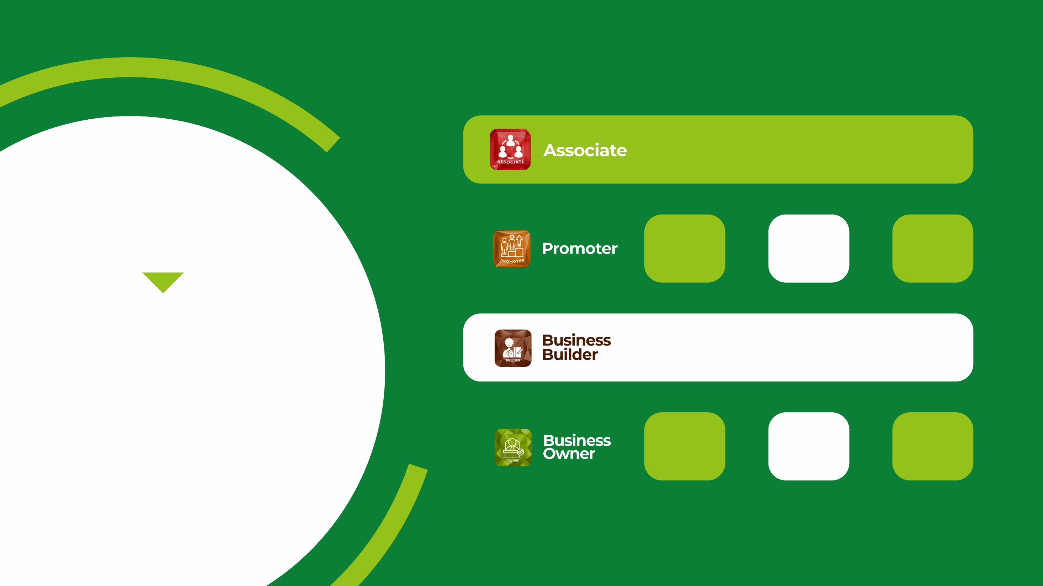
PRODUCT
BV
PRICE (NG₦’000)
73.6k
1
30
200k
3
90
840k
15
MEMBERSHIP PACKAGE
350
30
700
1,672k

Slide 5

WAYS OF EARNING
10

Slide 6

Retail Bonus
1

Slide 7

Repurchase Prices
Quantity
Wholesale (₦)
Retail Price (₦)
Profit (₦)
BV
1
10
56,000
64,000
8,000
2
20
107,520
128,000
20,480
4
40
206,080
253,440
47,360
6
60
295,680
378,240
82,560
8
80
376,320
501,760
125,440
10
100
448,000
624,000
176,000

Slide 8

Referral Bonus
This is a direct bonus earn on referrals
2

Slide 9
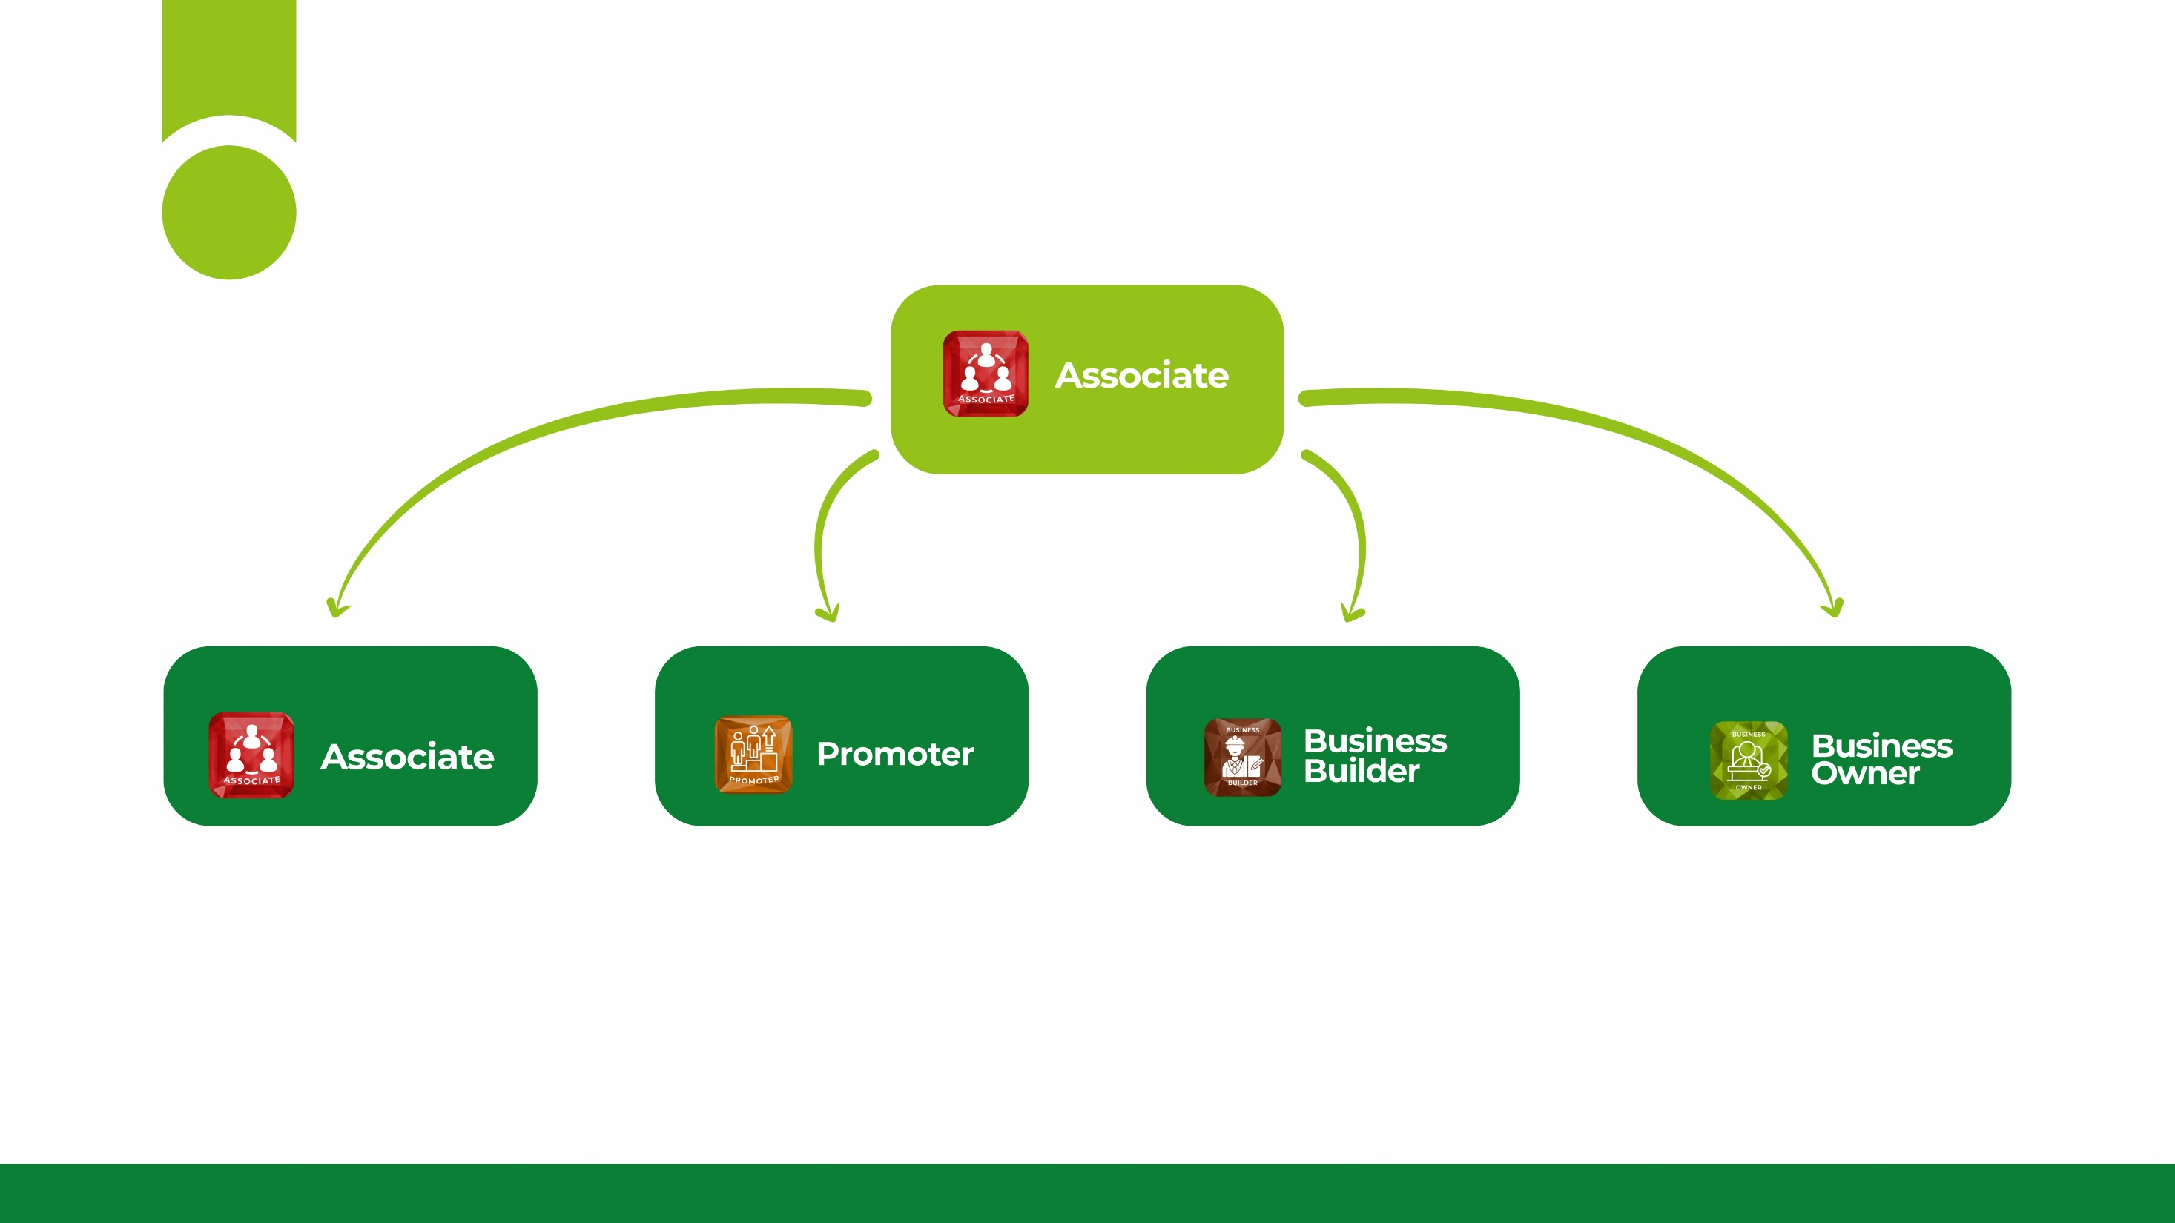
₦ 9,000 20% of BV
Referral Bonus
2
₦ 73,600
₦ 200,000
₦ 840,000
₦ 1,672,000
₦ 27,000 20% of BV
₦ 157,500 30% of BV
₦ 315,000 30% of BV

Slide 10
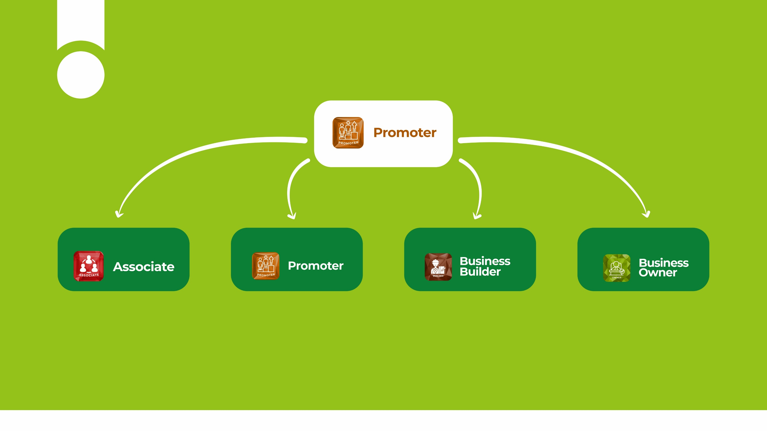
₦ 11,250 25% of BV
Referral Bonus
2
₦ 73,600
₦ 200,000
₦ 840,000
₦ 1,672,000
₦ 33,750 25% of BV
₦ 173,250 33% of BV
₦ 346,500 33% of BV

Slide 11
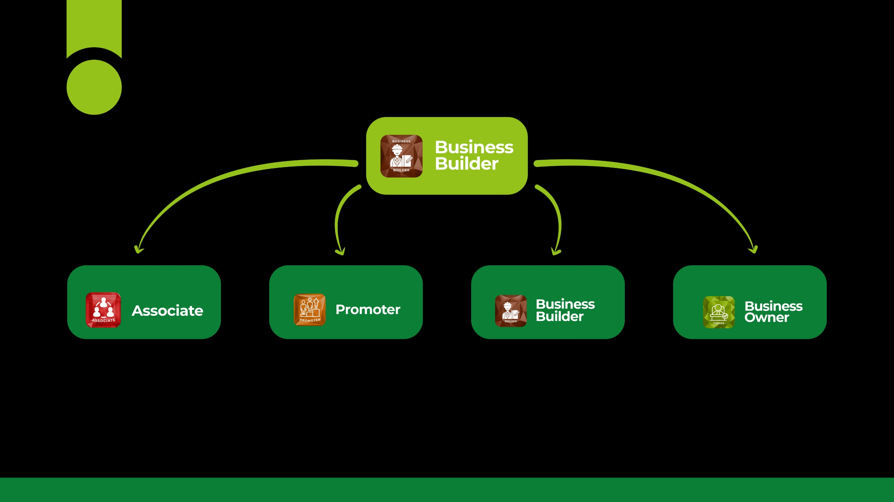
₦ 13,500 30% of BV
Referral Bonus
2
₦ 73,600
₦ 200,000
₦ 840,000
₦ 1,672,000
₦ 40,500 30% of BV
₦ 183,750 35% of BV
₦ 367,500 35% of BV

Slide 12
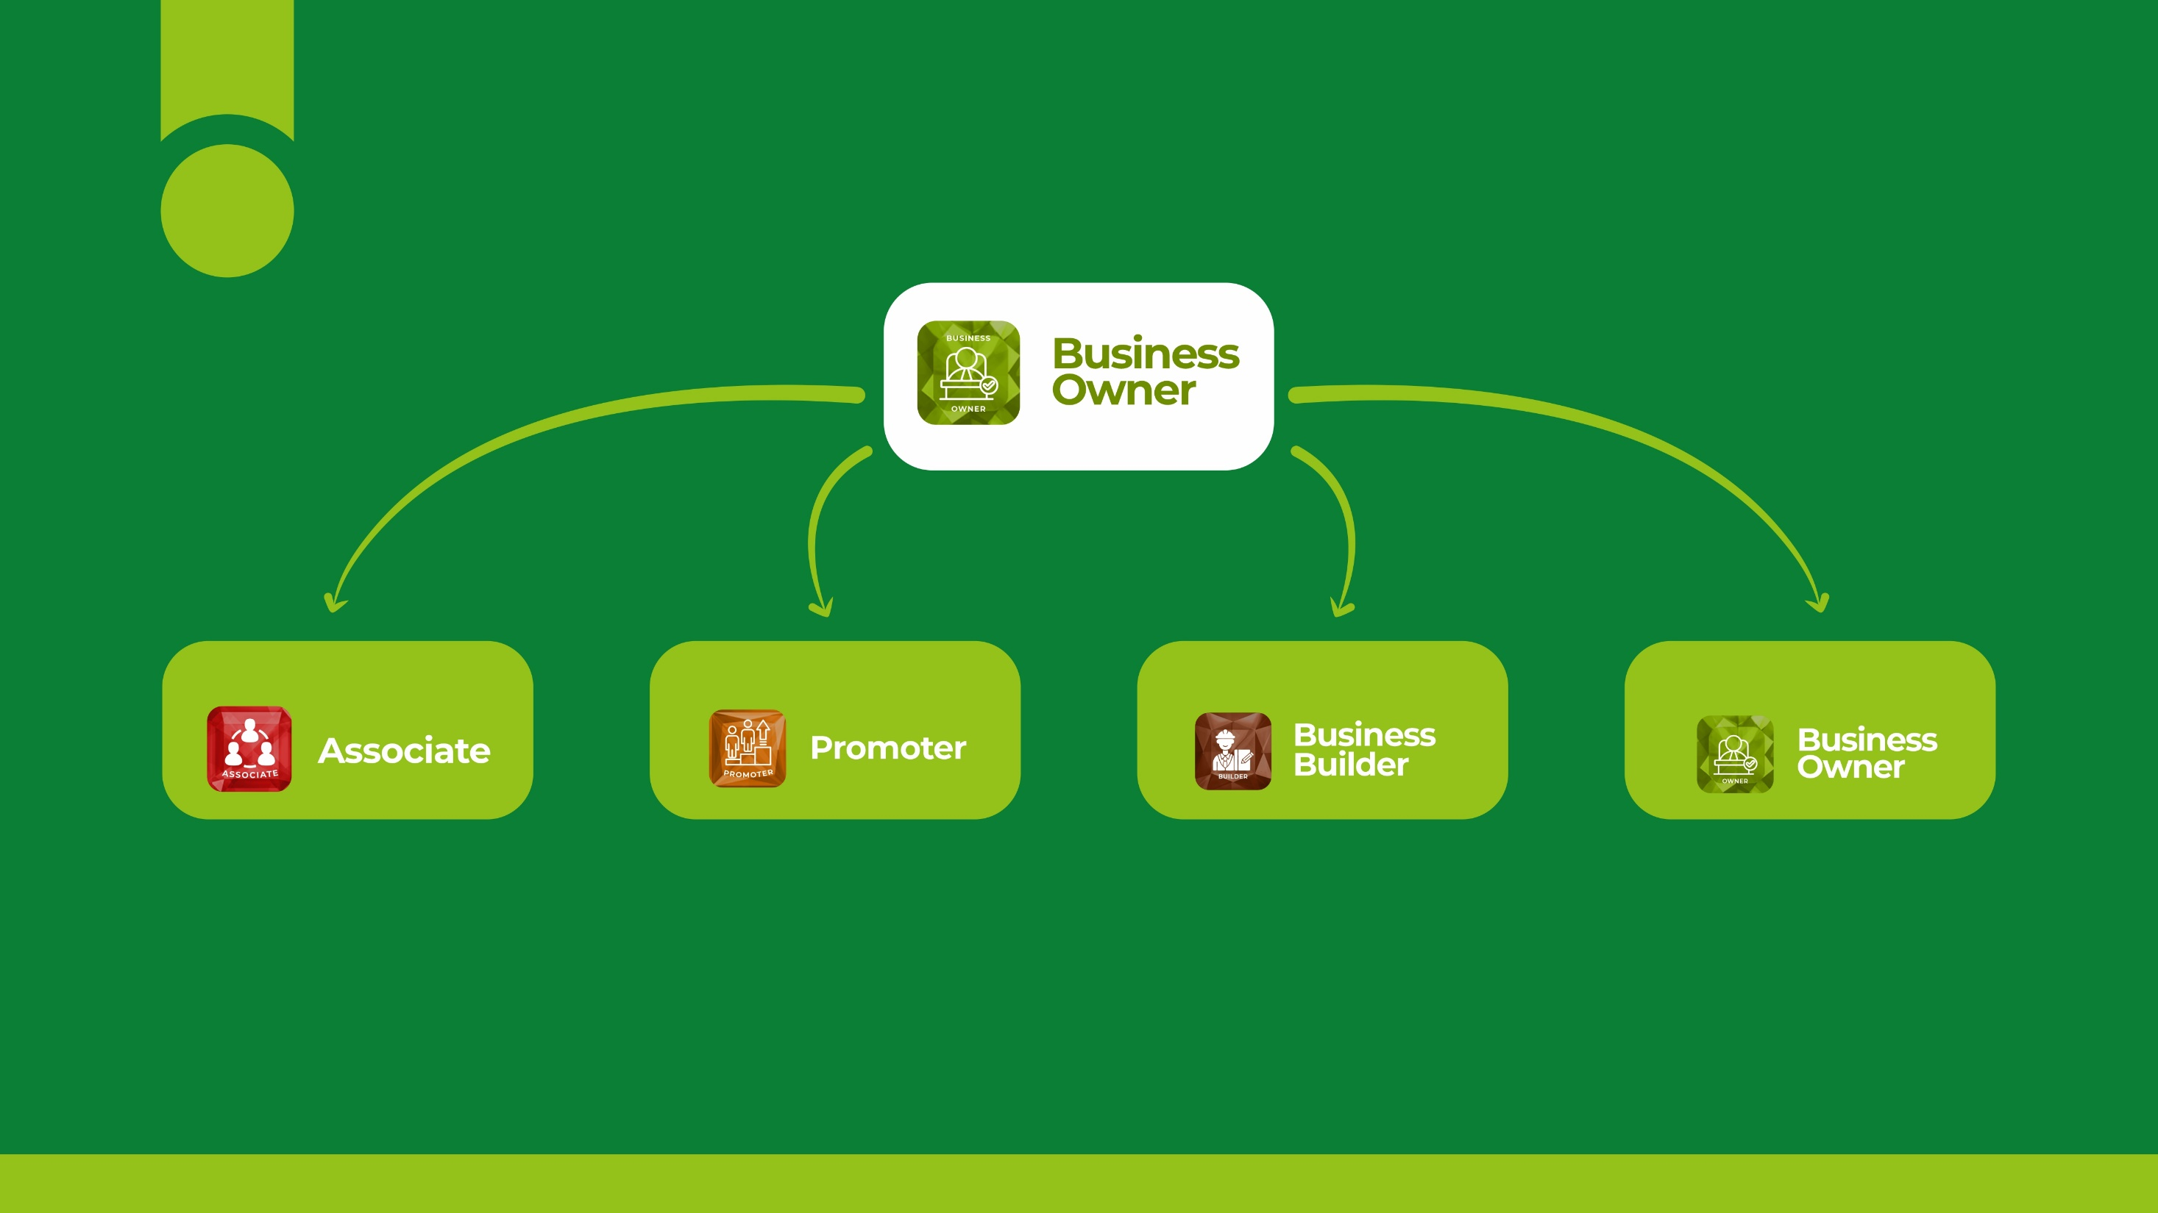
₦ 15,750 35% of BV
Referral Bonus
2
₦ 73,600
₦ 200,000
₦ 840,000
₦ 1,672,000
₦ 47,250 35% of BV
₦ 210,000 40% of BV
₦ 420,000 40% of BV

Slide 13

Upgrade Point/Bonus
3

Slide 14
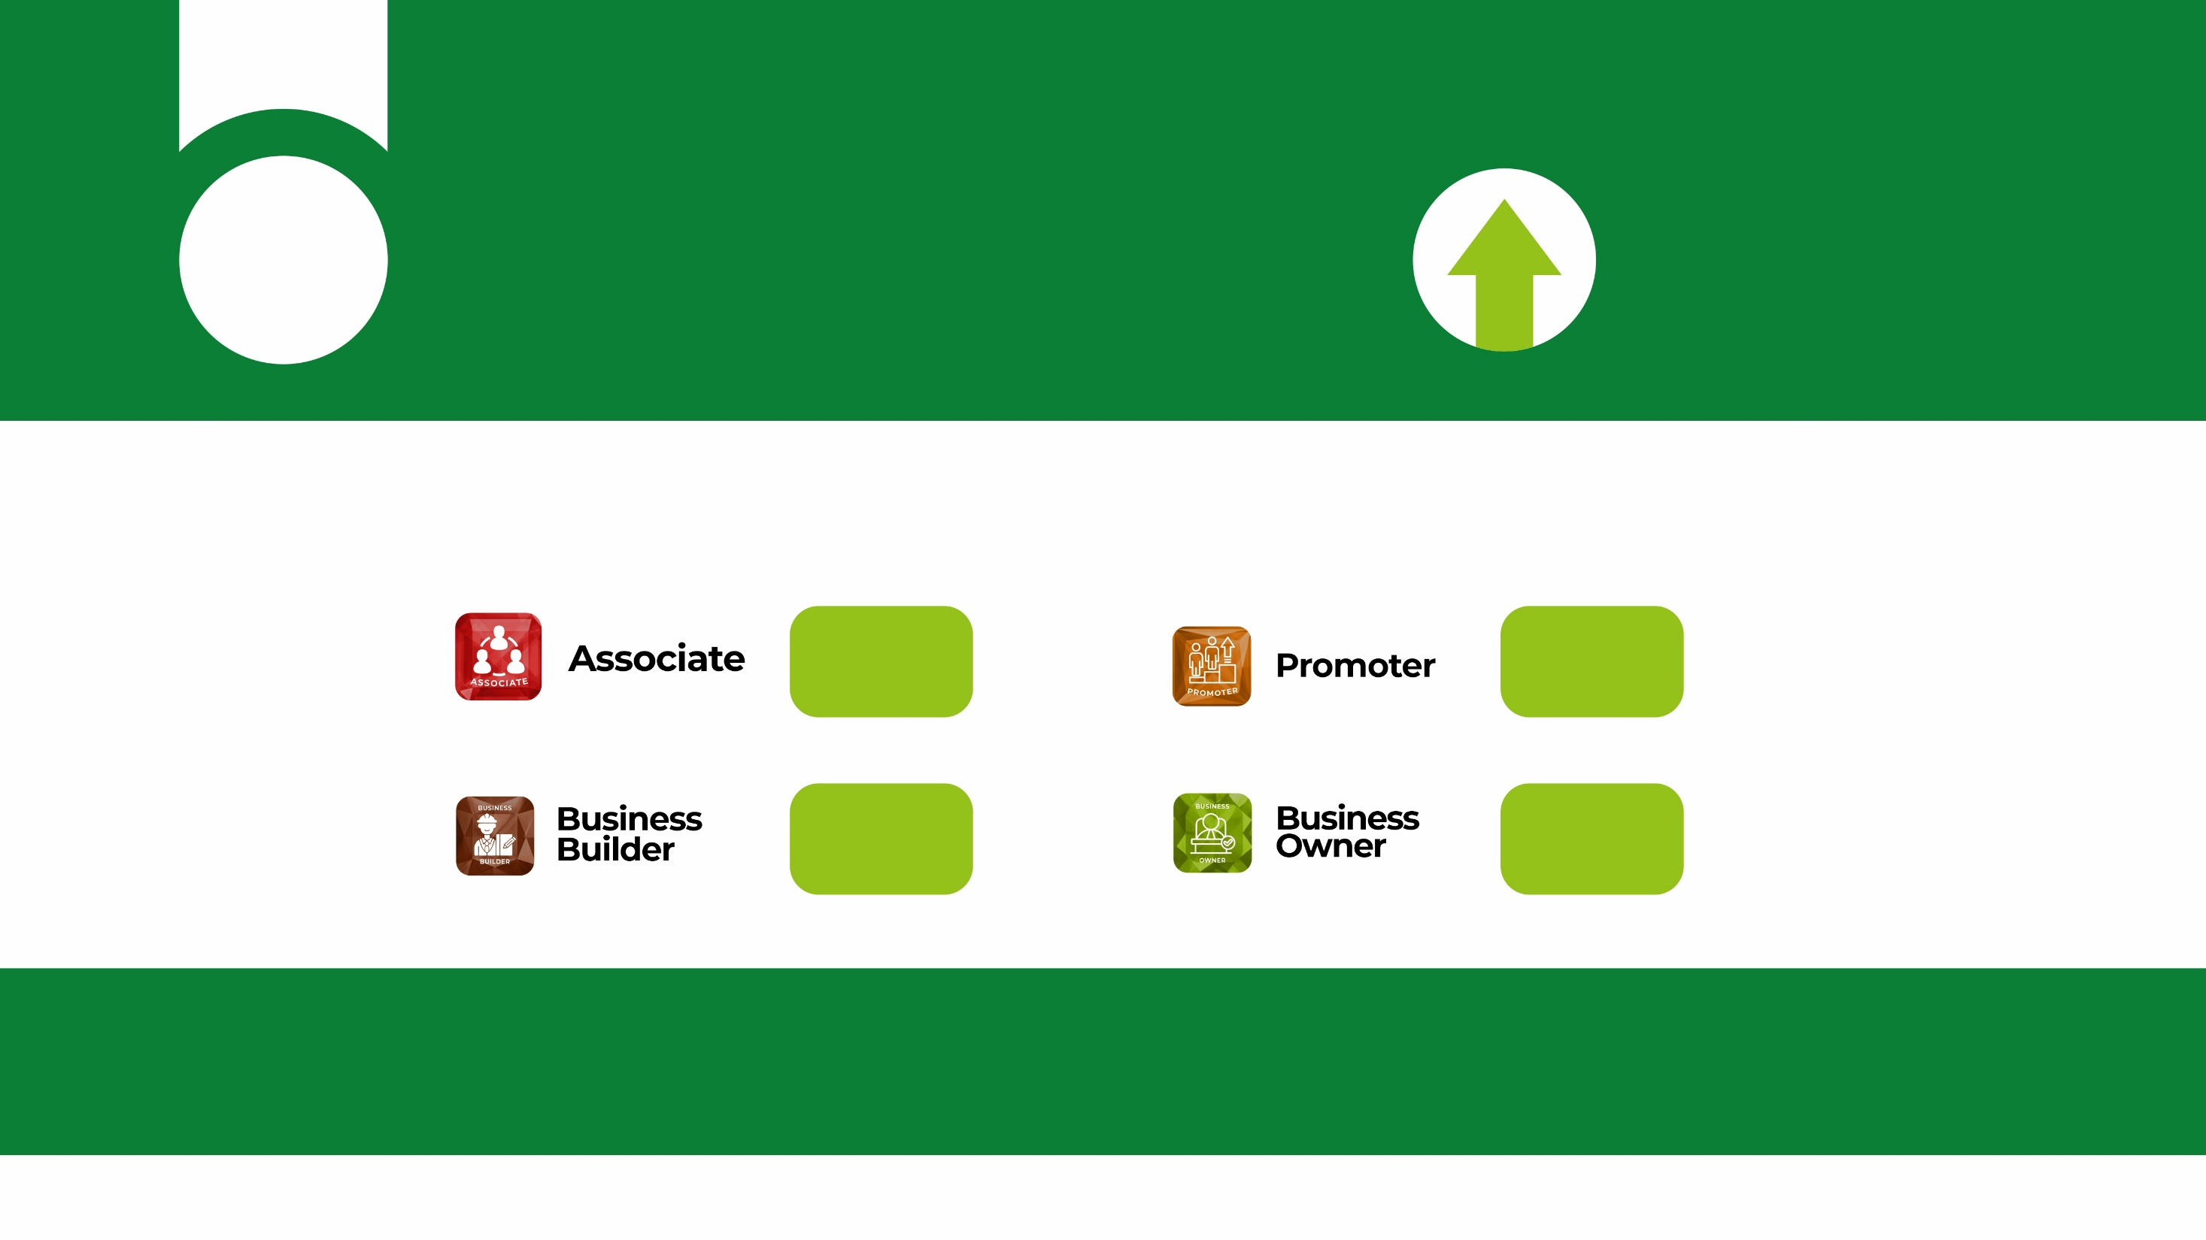
Upgrade Point/Bonus
3
The maximum payout for each package in Affluence Global:
₦ 15,750
₦ 47,250
₦ 210,000
₦ 420,000
For Example: If an Associate refers a Business Owner, he/she earns a direct Referral Bonus of ₦ 315,000
but the actual amount the company releases for payout is ₦ 420,000; therefore, the difference 420,000 – 315,000 = ₦ 105,000 will be credited to an Upgrade Wallet until it hits the desired amount for an affiliate to upgrade his/her status.
An Upgrade Bonus is paid out whenever a downline upgrades his/her account.

Slide 15

Team Commission
4

Slide 16
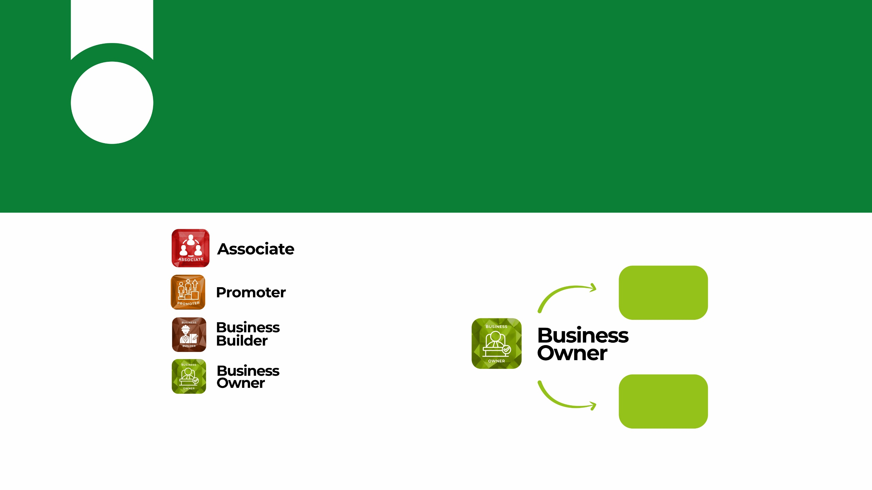
Team Commission
Team Commission is the heart of Affluence Compensation plan. An Affiliate earns a % of all the team volumes generated on the lesser leg. The % earn depends on the Affiliate membership package.
4
= 5%
= 7%
10,000
= 10%
= 12%
6,000
For Example:
12
x 6,000 = $720 x ₦1,500 = ₦ 1,080,000
100

Slide 17
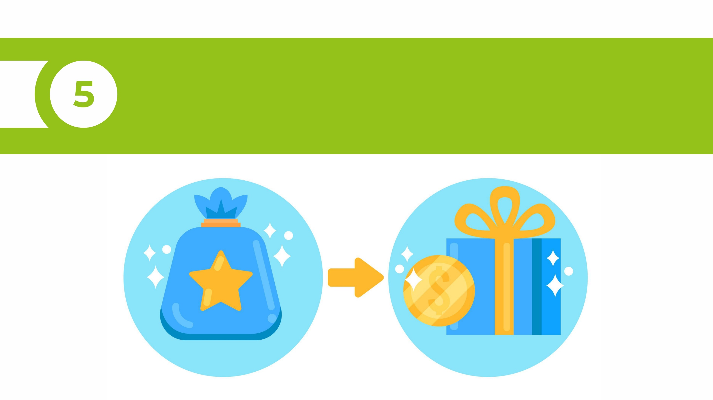
Momentum Bonus

Slide 18

Momentum Bonus
A percentage is paid on the Binary Commission earned
5
5%
7%
10%
13%
For Example:
If a Business Owner earned $10,000
13% will be paid on the $10,000 as Momentum Bonus.
13
x $10,000 = $1,300 x ₦1,500 = ₦1,950,000
100

Slide 19

Check-Match Upline Bonus
6

Slide 20

Check-Match Upline Bonus
6
When an affiliate hits
the following ranks, he/she
earns a percentage on the
binary earnings of his
immediate/direct upline.
Ranks
Percentage (%)
2%
3%
5%

Slide 21

Global Pool Bonus
7
10% of the Company Global profit will be shared among 10 pools.
Example, if the company makes a profit of $1 Million,
5%
7%
10
x $1m = $100,000 x ₦1,500 = ₦ 150,000,000
100
$100,000
= $10,000x ₦1,500 = ₦ 15,000,000
10
Each Pool will share
₦ 15,000,000

Slide 22
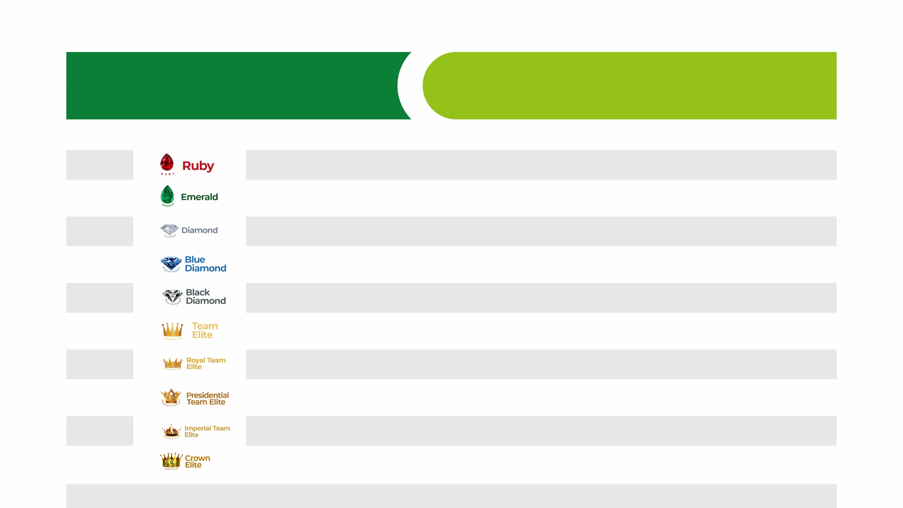
Ranks
Global Pool Bonus
US$
₦
10,000
15,000,000
10,000
15,000,000
10,000
15,000,000
10,000
15,000,000
10,000
15,000,000
10,000
15,000,000
10,000
15,000,000
10,000
15,000,000
10,000
15,000,000
10,000
15,000,000

Slide 23

Personal Purchase Bonus
8
Affluence Global will pay back 10% on the
volume of all personal purchases made by
an affiliate in the Unilevel
Example, If an affiliate made a personal purchase
of product and this purchase generates
a personal volume of 500BV
10
x 500 = $50 x ₦1,500
100
= ₦75,000

Slide 24

Compressed Unilevel Bonus
9
This a generational bonus.

Slide 25
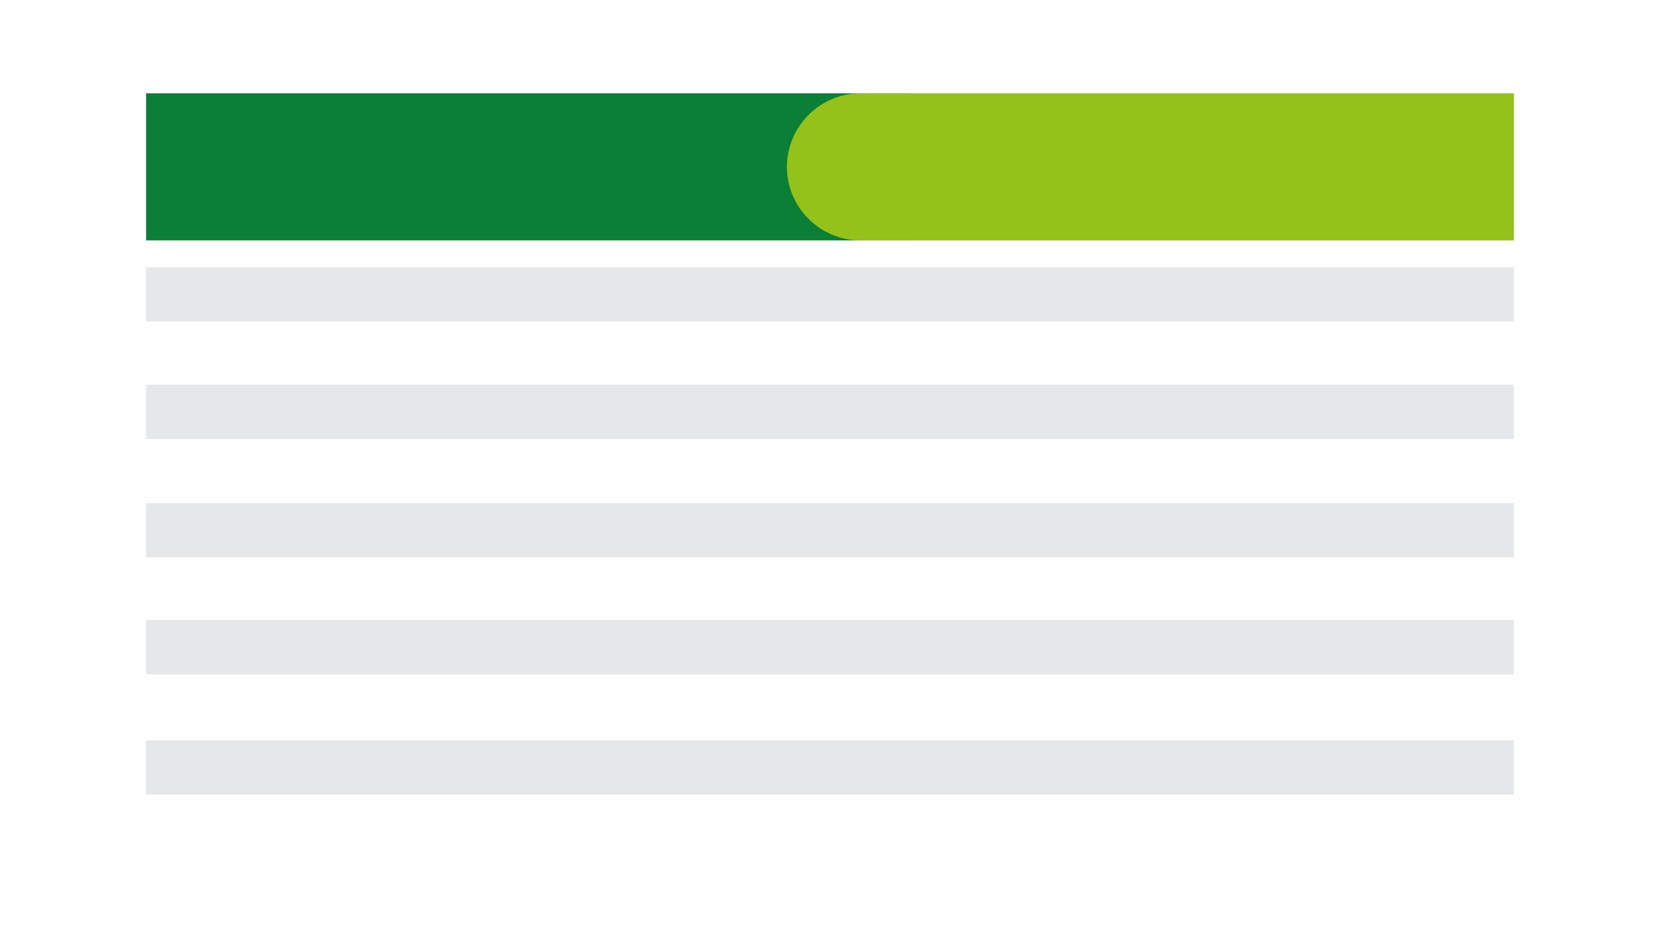
LEVELS
UNILEVEL (%)
1
9
2
7
3
5
4
5
5
5
6
2
7
1
8
1
9
1
10
1

Slide 26
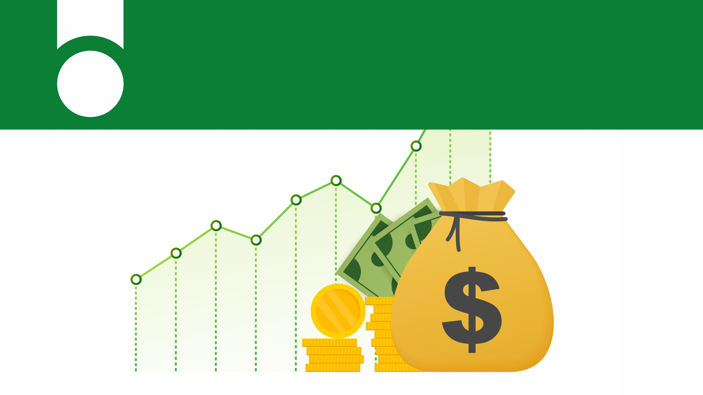
Unilevel Check-Match Commission
10

Slide 27

LEVELS
1
2
3
4
5
15
10
5
5
3
CHECK-MATCH (%)

Slide 28

ADDIDTIONAL BENEFITS
Incentives
Hall of Fame

Slide 29

RANKS
RANKS IN AFFLUENCE GLOBAL
CUMULATIVE AMOUNT ($)
INCENTIVES
3,000
Rice Cooker
5,000
Microwave
10,000
Utensils/ Iron & Blender
25,000
Projector
50,000
Laptop i7
100,000
Fridge / iPad Air Pro
150,000
Freezer / Mac Book Pro
250,000
Washing Machine / 75 inch
UHD 4K QLED TV
500,000
Landcruiser V8 / Lexus 570 / Range Rover
700,000
G-Wagon
1,000,000
2 Bedroom
2,000,000
3 Bedroom Apartment
3,000,000
4 Bedroom Apartment

Slide 30

HALL OF FAME

Slide 31

Affluence Global Hall of Fame
OPTION 1
OPTION 2
Earn Cumulative Personal volume
of 500,000 BV in the Unilevel;
Earn $1 Million Cumulative Commission
Affluence Global Loyalty Card
Affluence Global Loyalty Card
₦4,500,000 will be loaded on this card every month for a period of 1 year.
₦4,500,000 will be loaded on this card every month for a period of 1 year.
All Global events sponsored by the
company (Trips and Accommodation)
All Global events sponsored by the
company (Trips and Accommodation)
A brand-new executive car worth ₦45,000,000

Slide 32

2 LAWS OF EARNING (Law of Singleness vs Law of Leverage)
The law of singleness (employment)
The law of leverage (the key to exponential wealth)

Slide 33


True Financial Freedom
Can Only Be Achieved If... YOU PUT THE POWER OF
LEVERAGE
TO WORK FOR YOU!

Slide 34






Invest in a company you can depend on
Establish Custom-Bonded Warehouses to Serve each Subregion of Africa (North, South, East & West)
Partner with Canada & China to Set-Up a Factory in the heart of Africa
Factory
To construct a high-quality but affordable customer-focused housing unit
Rank Incentives and Awards
Real Estate
Partner with one of the fastest growing EV Companies in the world
Rank Incentives and Awards
Electric
Vehicles

Slide 35


GET READY TO REACH
YOUR FULL POTENTIAL
WITH

Slide 36


